Slide 1


Devin’s Game
Peter Smith

Slide 2
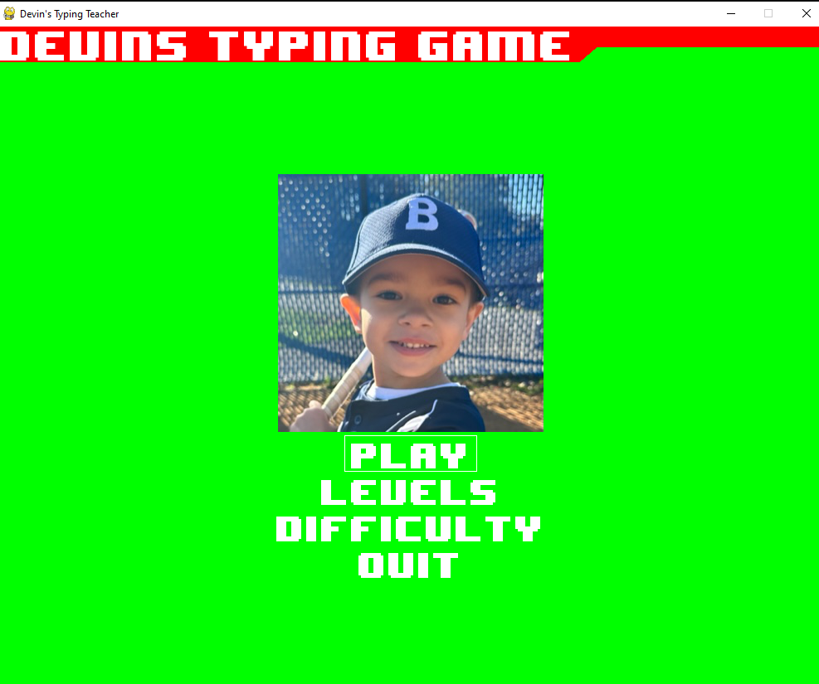
Description
Devin’s Game is a typing tutor that allows my son to play a personalized typing game that was specifically designed for him.
It includes multiple menus and levels.

Slide 3
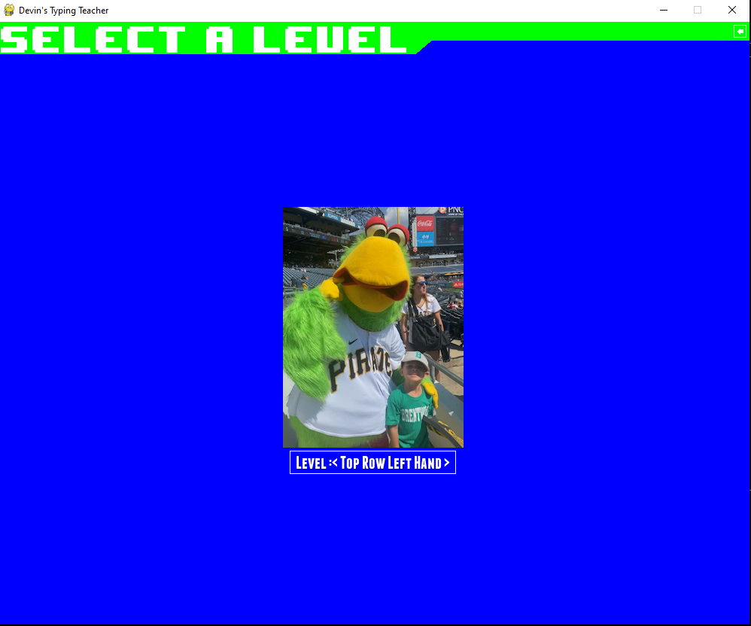
Menus
There are three menus and a loading screen involved in the game.
The two submenus allow for level selection and difficulty selection.

Slide 4

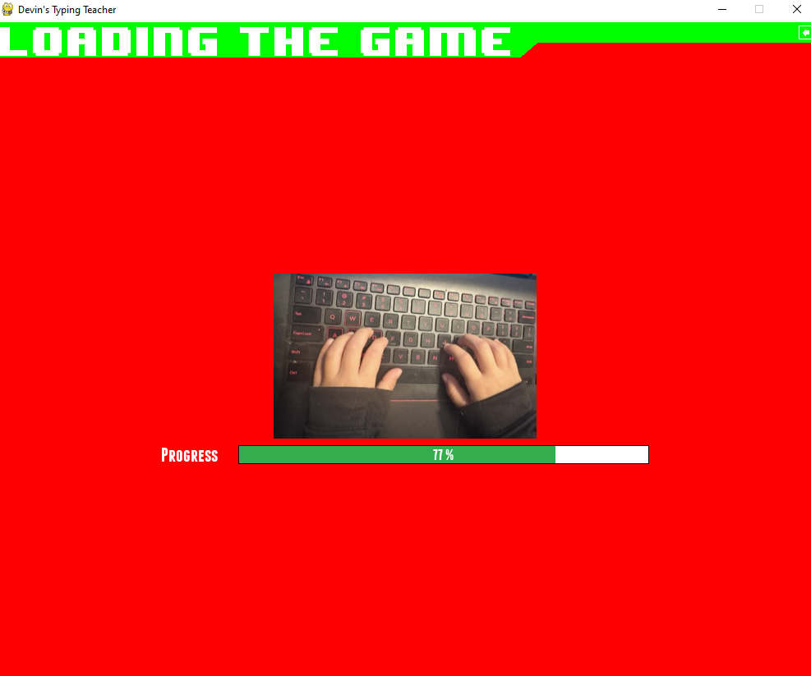
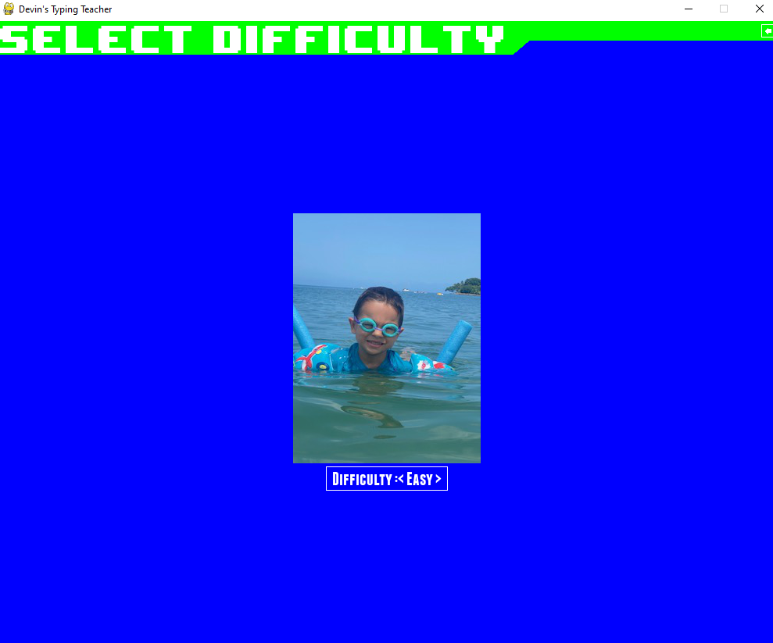
More Menus

Slide 5
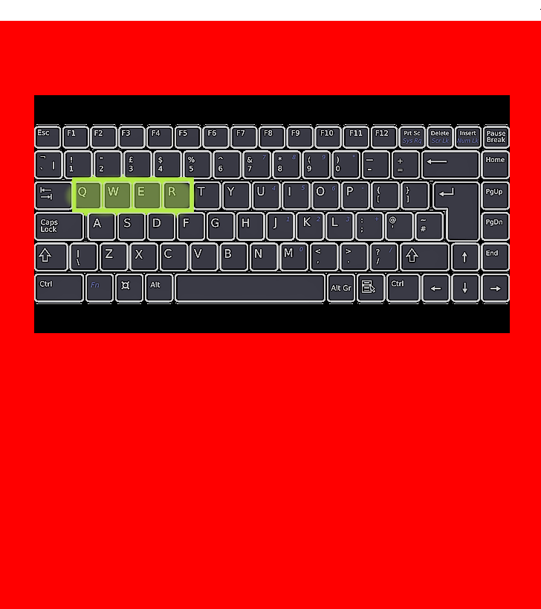

Level Design
At the beginning of each level there is a brief description of the keys that are being used in the level as well as a visual aid.
The game then begins and will show an image of a letter and allow an allotted time to press the proper key.

Slide 6
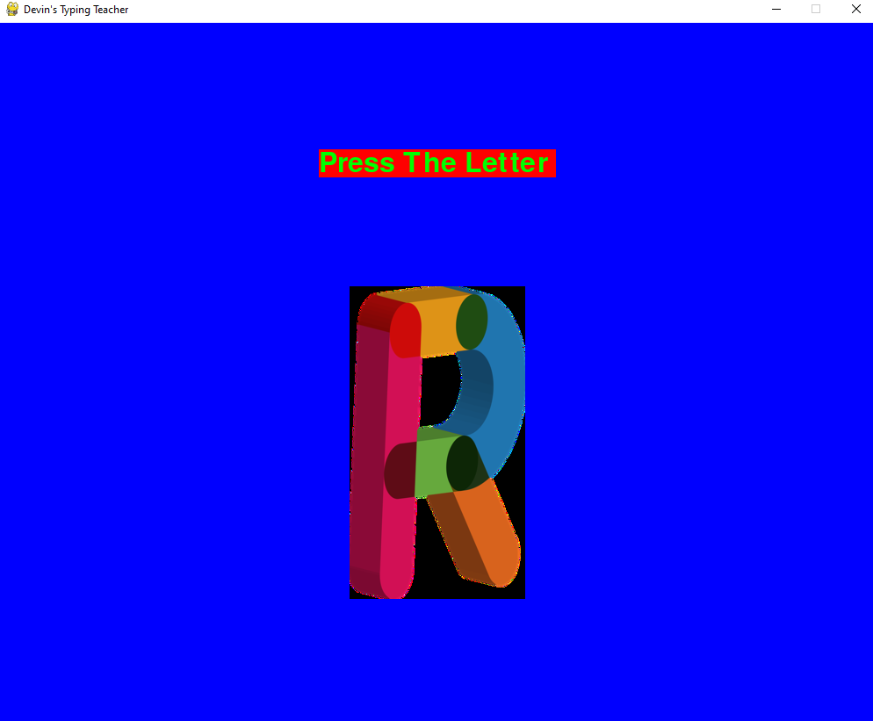
Level Design
If an incorrect key is pressed or the timer runs out a “try again” message appears.
If the proper key is selected a “great job” message displays.

Slide 7
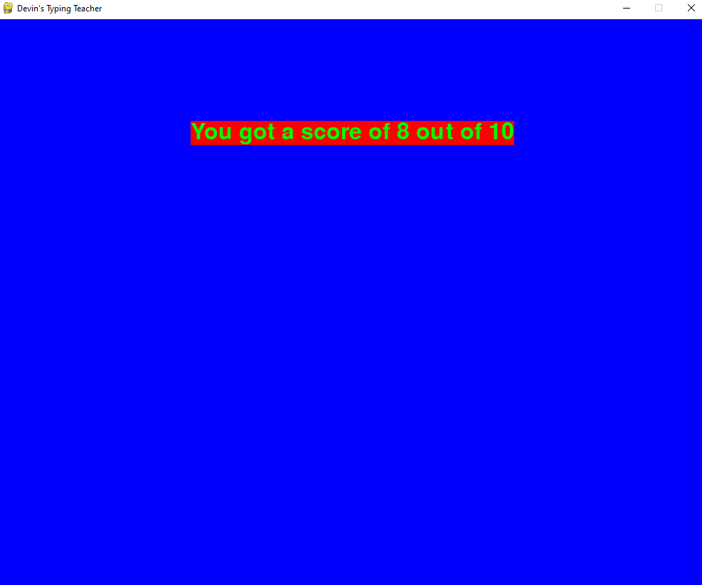
Level Design
Once the level completes a screen will appear showing the score of the level.
The game will then revert to the main menu.

Slide 8
Please enjoy the video presentation of Devin’s Game

